Slide 1


Cluster Analysis for
Newsletter Personalization
Team: Kelly Zhao, Ray Liu, David Chen,
De Lu, Lily Chou
Notes:
Hi everyone, Our 5-people team is so excited to share out work (Topic). I’m xx, I’m xx, I’m xx, ..

Slide 2
BUSINESS OBJECTIVE
01
CLUSTER ANALYSIS
02
CLUSTER PROFILING
03
RECOMMENDATION
04
AGENDA
VALIDATION
05

Slide 3

01
BUSINESS OBJECTIVE

Slide 4
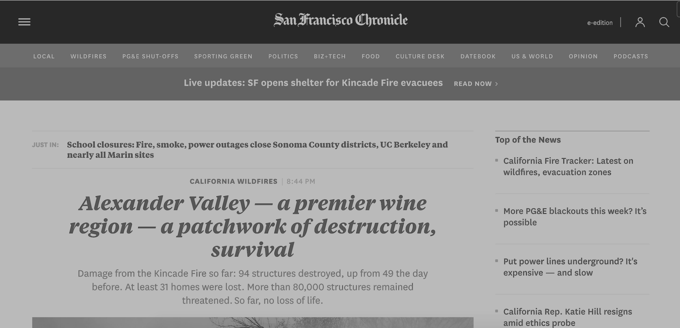
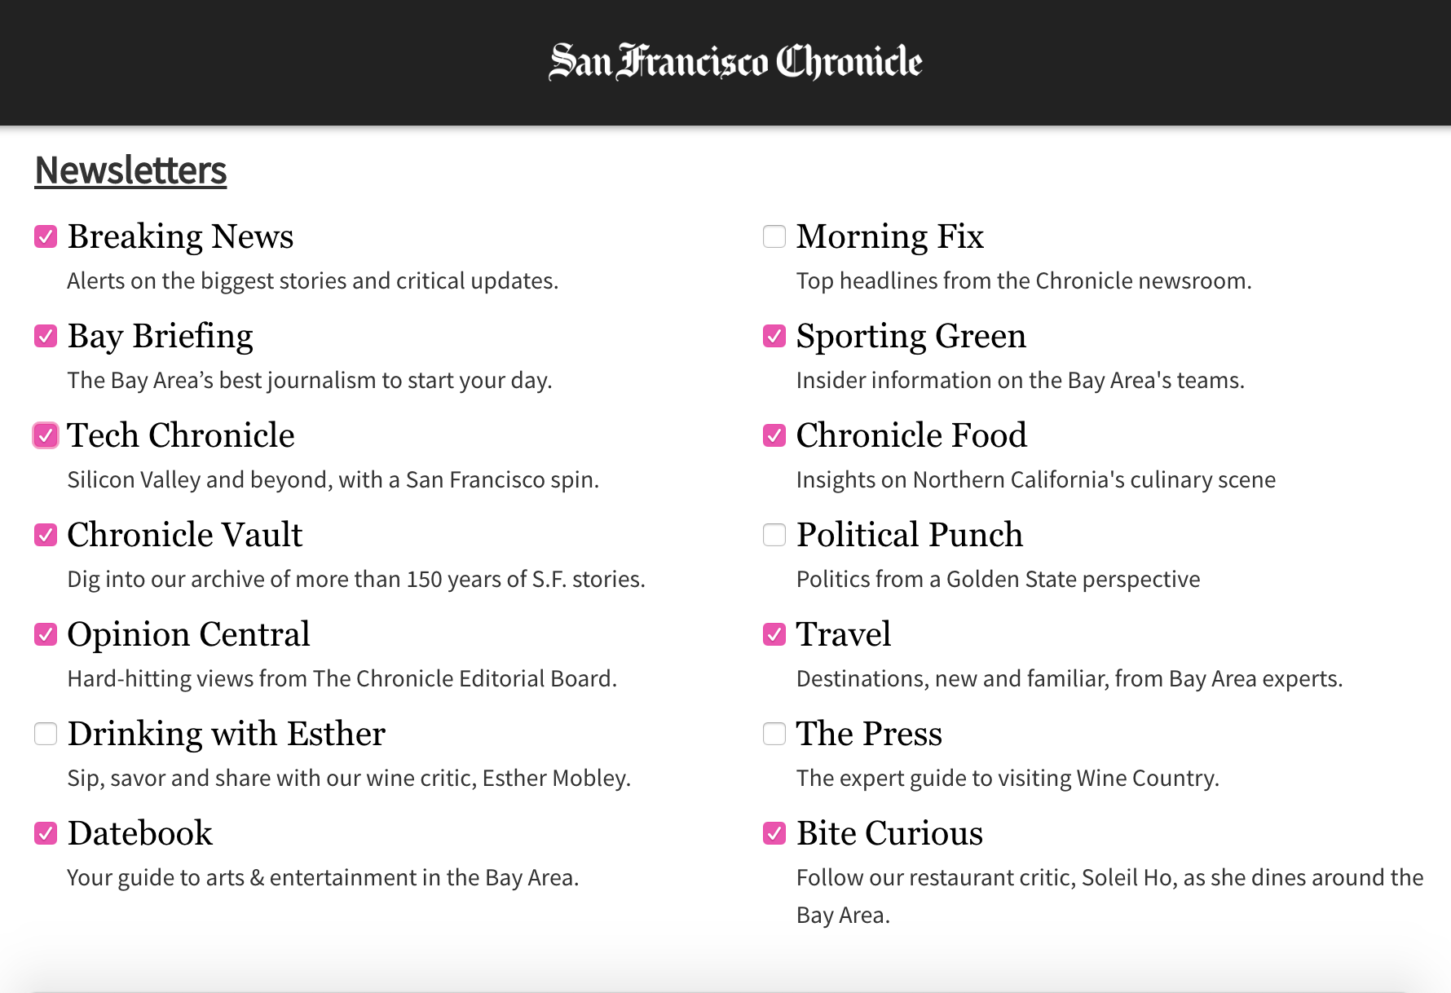
BUSINESS OBJECTIVE
Personalize Newsletters to the news readers to increase reader engagement. Index: Increase weekly mean reading time, number of sessions, and subscription renewal

Slide 5
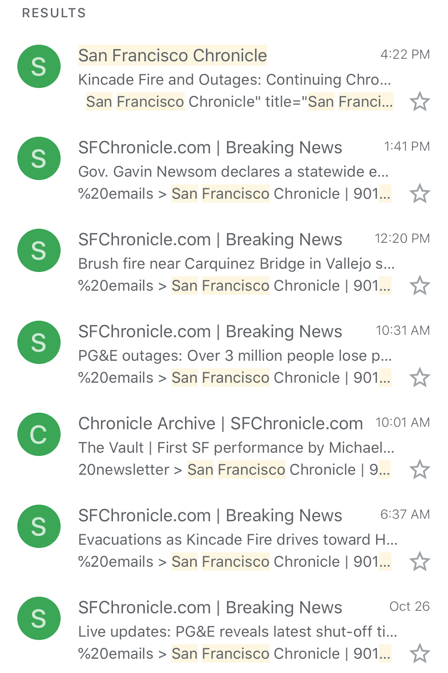
Personalization based on topics
6 News/Day
Task: Providing news the user most likely to read
Question: Which topic does he/she read?
Variables for clustering: Log(SumNumbers+1) of each topic read by each subscription ID

Slide 6

02
CLUSTER
ANALYSIS

Slide 7
Cluster Methodology
Cluster by Overall Content Category
Deep Dive into News
Deep Dive into Sports
Deep Dive into Food
Profiling
Personalization

Slide 8
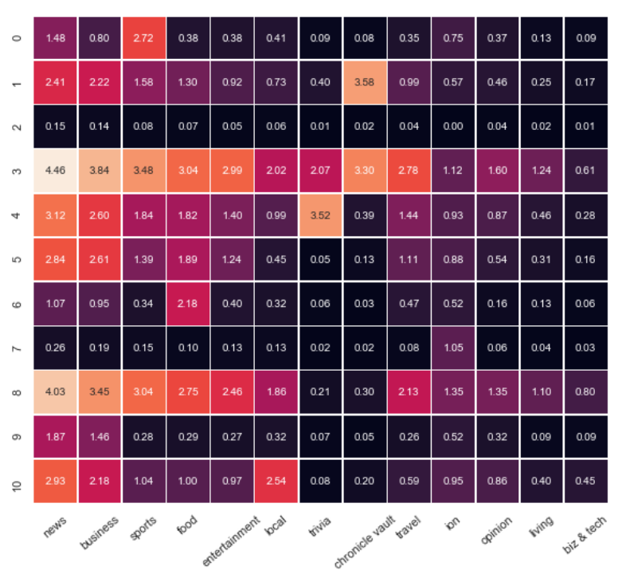
Cluster by Content Category
5.55% not very active / sports only
2.45% active / chronicle vault, news, business
36.31% inactive
2.27% highly active / news, business, sports, food
3.44% medium active / trivia, news, business
7.03% medium active / news, business, Food
5.71% light reader / food only
16.12% inactive / ion only
3.58% active / news, business, sports, food
13.67% not very active / news, business
16.12% inactive / ion only
Notes:
Y axis : 11 clusters
X axis : 13 content topics.
Color : The darker colors, the lower the values.
Light / Medium/ Heavy
Aggregate the content variables grouping by subscriptionid to sum them, and log them in order to get a normal distribution. The mean of log values in every clusters is THAT number.

Slide 9
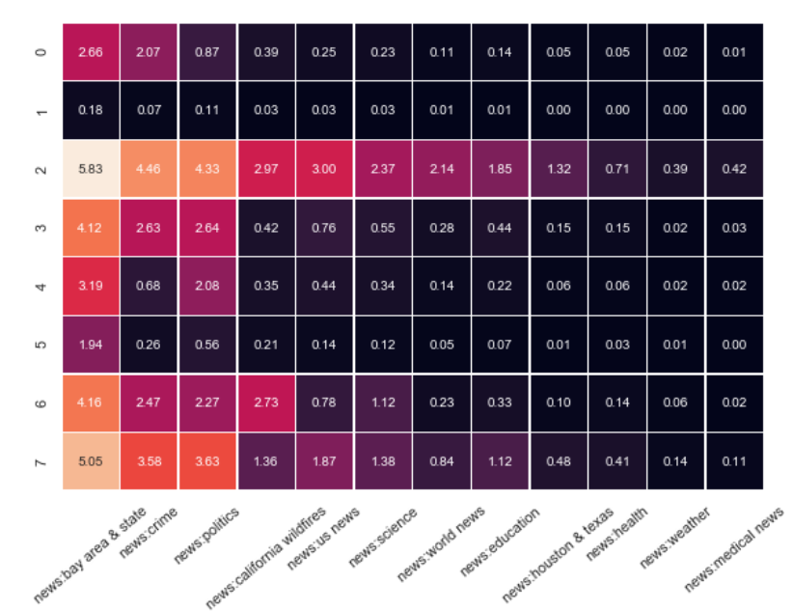
Deep Dive into “News”
7.66% inactive/ bay area,crime
42.70% Inactive / all kinds of news
2.16% active / broad interest
8.47% active / local+crime+politics
10.29% active / local news+politics
18.02% active / local news only
5.02% active / local, crime, politics, wirefires
5.69% active / local+political+crime

Slide 10
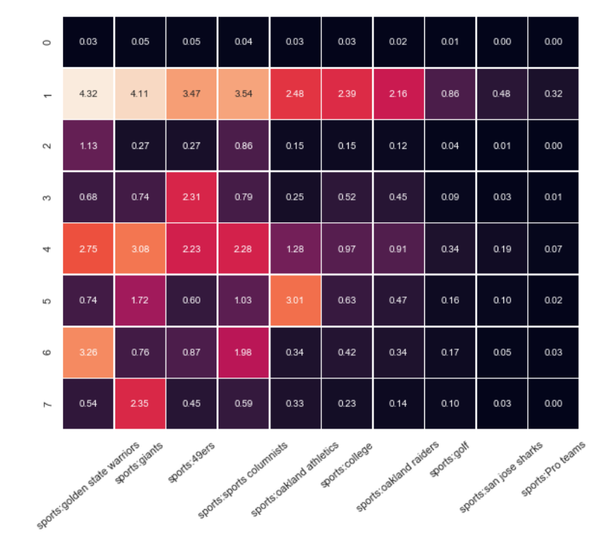
Deep Dive into “Sports”
71.36% inactive
1.91% Inactive / board interest
8.52% almost inactive/ basketball+columnists
3.46% active / 49ers lovers
4.11% medium active / broad interest
1.57% active / baseball
3.94% active / local news + politics
5.13% active / giant (baseball) lovers

Slide 11
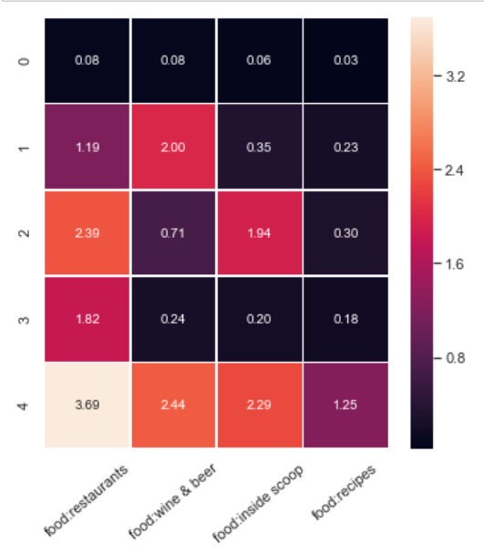
Deep Dive into “Food”
69.04% inactive
7.13% active / alcohol lover
6.56% active / restaurant explorers
12.95% medium active / restaurants only
4.32% active / food expert - all kind & cook themselves

Slide 12

03
HIGHER LEVEL
SUMMARY

Slide 13
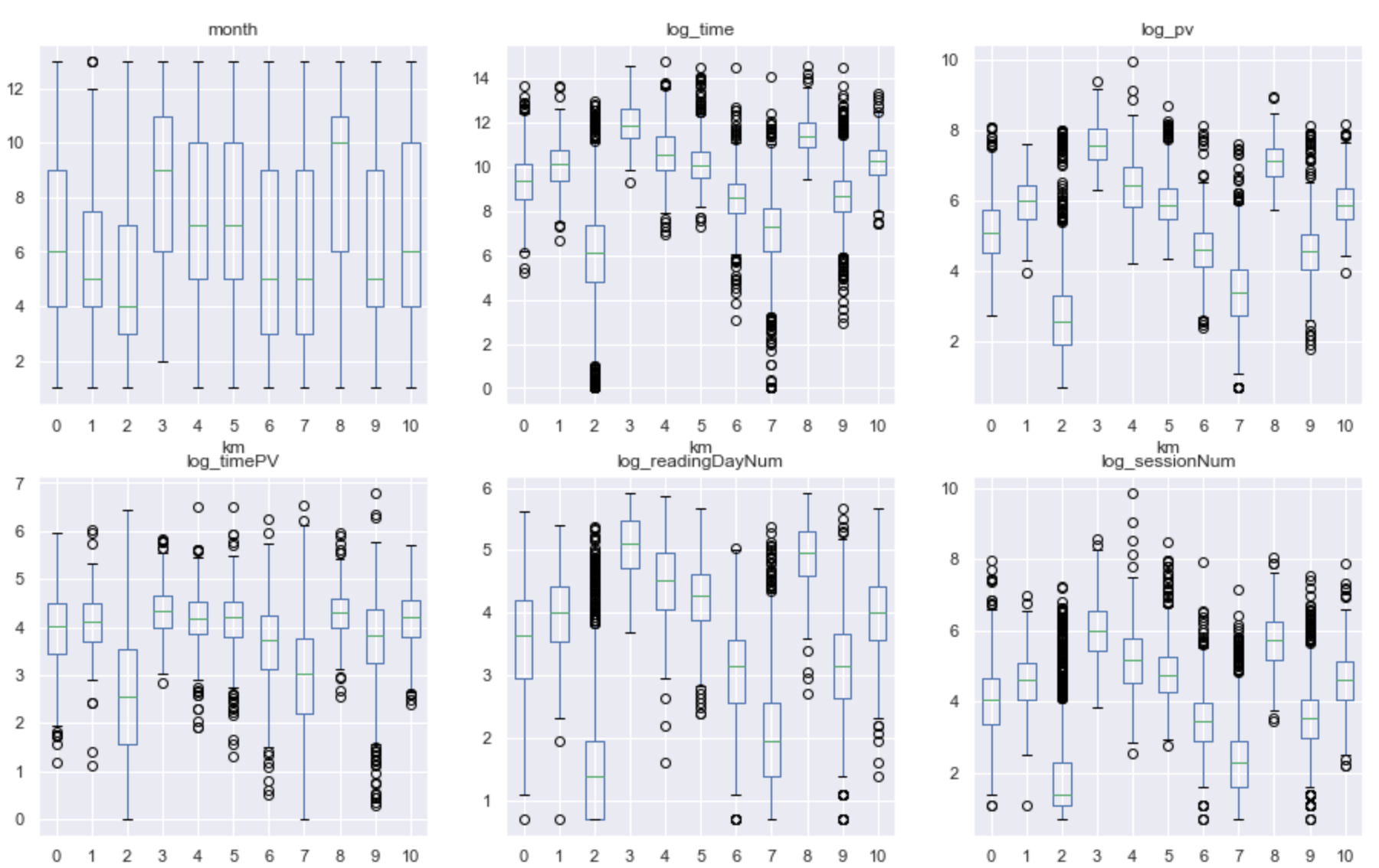
Higher Level Summary Variables
Month-Loyalty
Time(Sum)
Pagesviews
0 not very active / sports only
1 active / chronicle vault, news, business
2 inactive
3 highly active / news, business, sports, food
4 medium active / trivia, news, business
5 medium active / news, business, Food
6 light reader / food only
7 inactive / ion only
8 active / news, business, sports, food
9 not very active / news, business
10 inactive / ion only
Time per page
Reading Day Number
Session Number

Slide 14
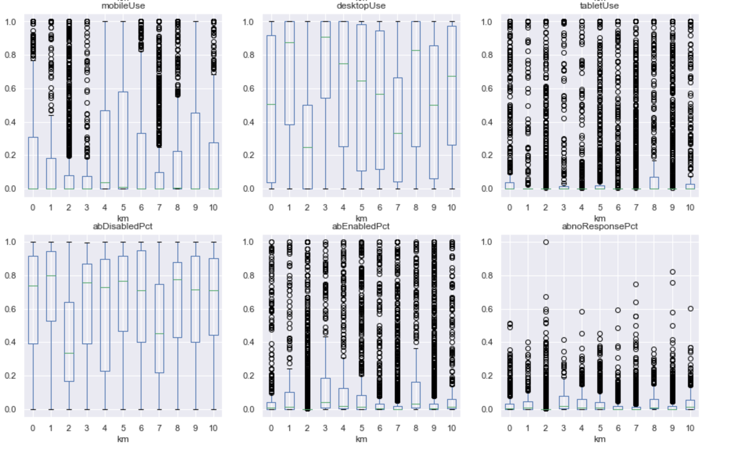
Higher Level Summary Variables
Device - Mobile
Device - Desktop
Device- Tablet
0 not very active / sports only
1 active / chronicle vault, news, business
2 inactive
3 highly active / news, business, sports, food
4 medium active / trivia, news, business
5 medium active / news, business, Food
6 light reader / food only
7 inactive / ion only
8 active / news, business, sports, food
9 not very active / news, business
10 inactive / ion only
Ad block = 1
Ad block = 0
No response to Ad block

Slide 15
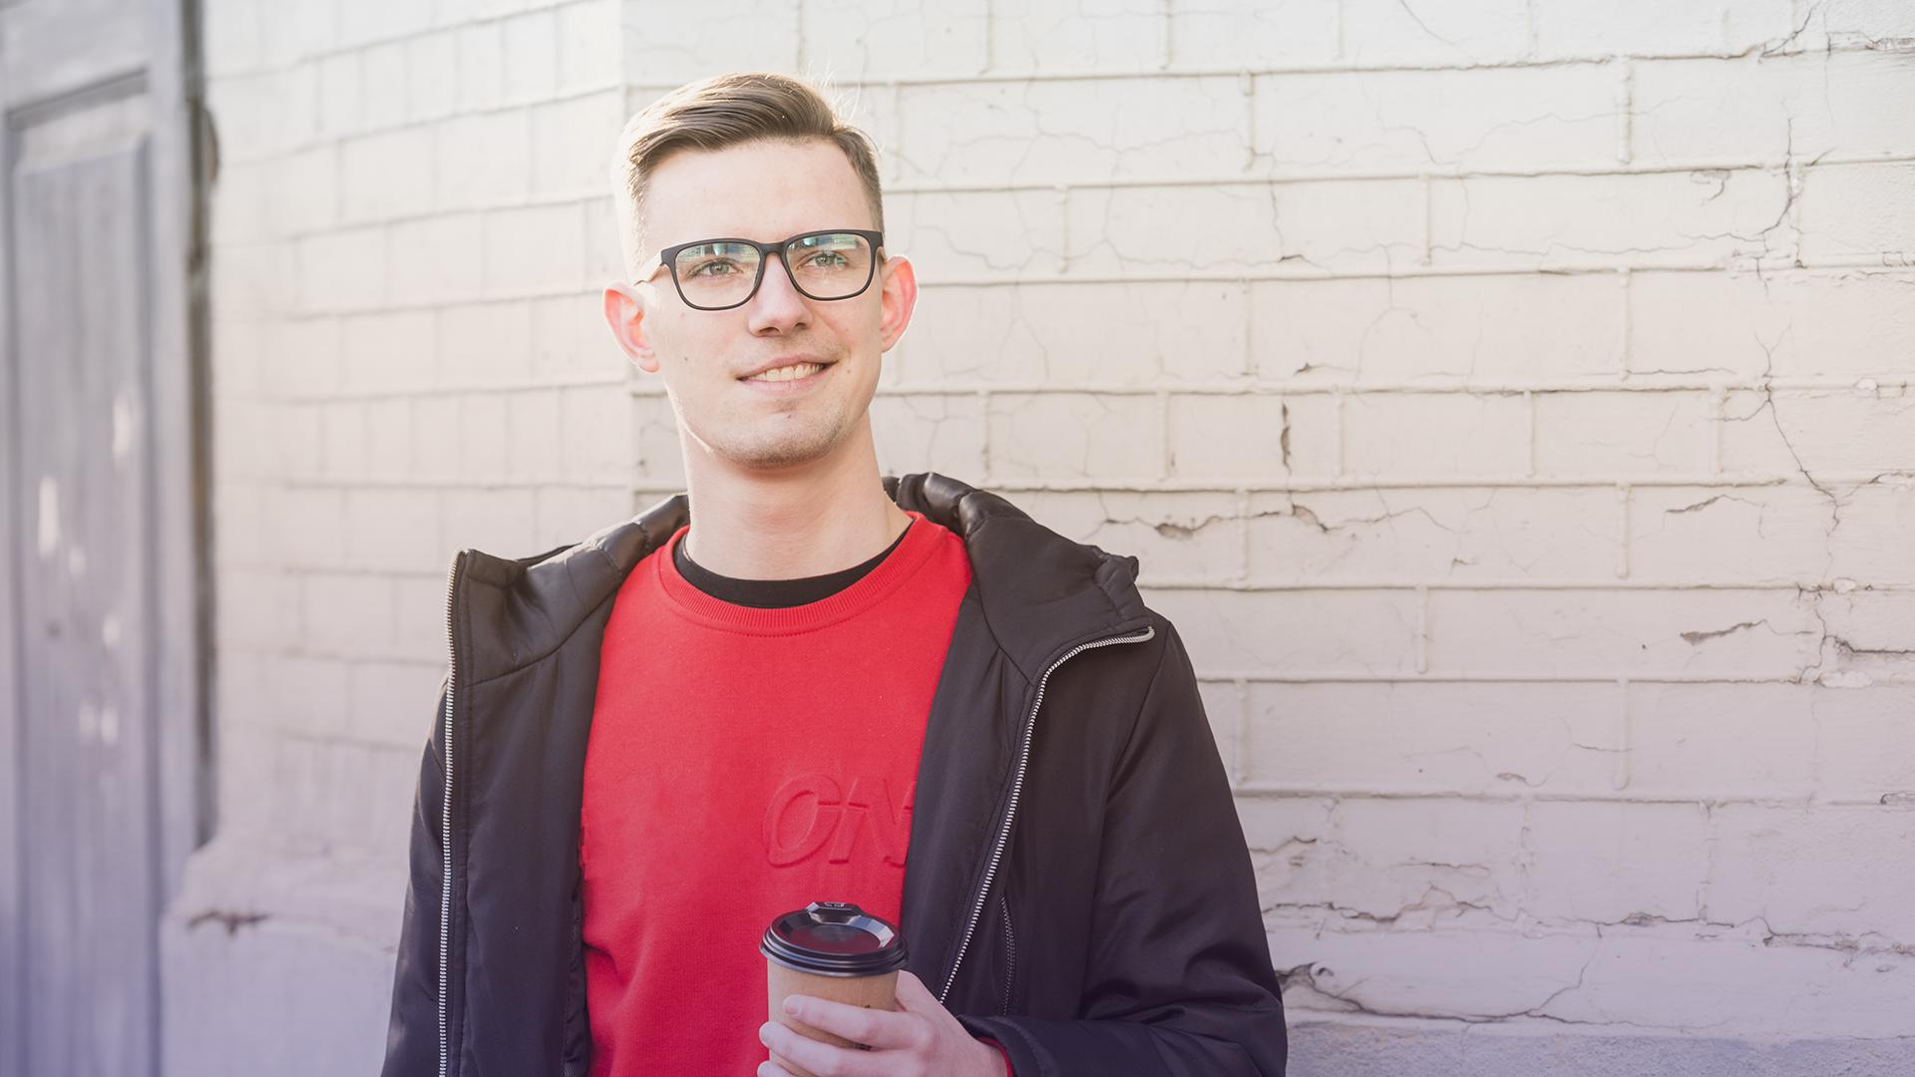
04
RECOMMENDATION

Slide 16
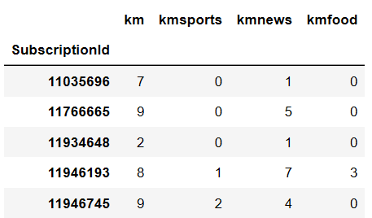
Personalization
A demo of content label by ID
Deliver personalized newsletter based on general category interest & subcategories (News/Sports/Food)
LAURA PATTERSON
“Neptune is the farthest planet from the Sun and the fourth-largest in our Solar System!”
Example customer ID 11946193:
General category → 3.58% active / News, Business , Sports, Food
Subcategory :
Sports 1→ board interest
News 7→ local + political + crime
Food 3→ restaurants only

Slide 17
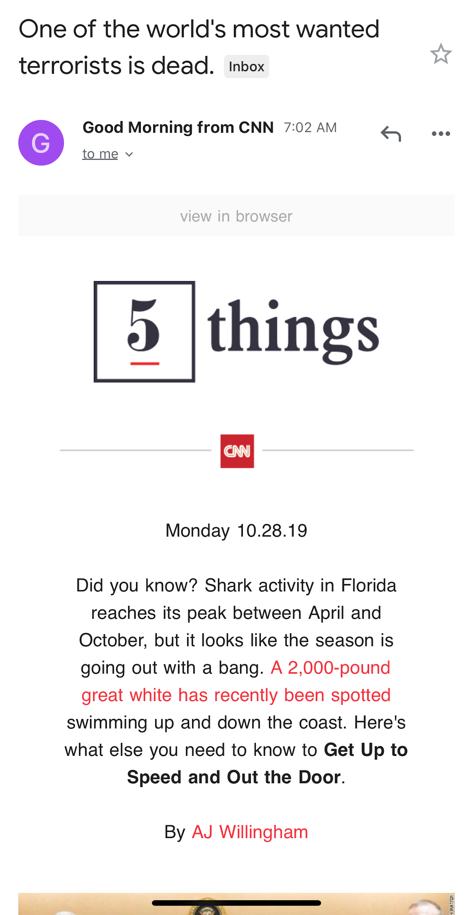
Personalized Newsletters for Skimmers
Current :
6 newsletter emails per day per person
Suggestions:
Personalize & Summarize into 1 email with 6 news brief
based on each reader’s category & subcategory label.
skimmer (higher PV/time)
News
Sport
Biz
Food
Notes:
Re-engage with the inactive users → win them back

Slide 18

05
Measurement

Slide 19
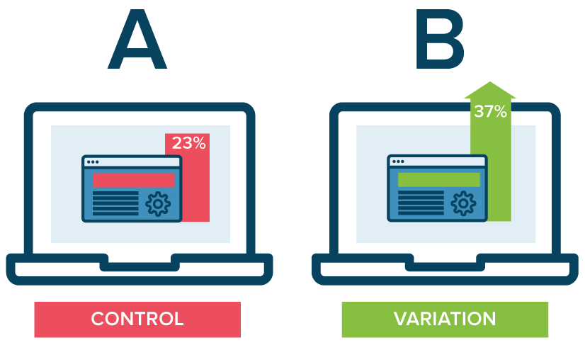
How do we measure success -
A/B Testing
Index
Mean reading time and number of sessions, and subscription renewal
Hypothesis
index will increase after applying the new personalization strategy to San Francisco Chronicle.
The designed experiment
Randomly select 10,000 users for Group A and 10,000 Users for Group B.
Day 1 - 7: Record index (A and B should be similar)
Day 8 - 14: Apply new personalization to Group B only. Record index.

Slide 20
How do we measure success -
A/B Testing
Validation
Compare index between Group A and B (Day 1 - 7), and Group A, between Day 1-7 and 8 to 14.
expected to be the same. If not, adjust the portion
Compare index between Group A and B (Day 8 - 14)
group B is expected to be grater.
Compare index of Group B, between Day 1-7 and 8 to 14.
Day 8 to 14 is expected to be grater.
Day 8-14
Day 1-7

Slide 21
THANKS
Does anyone have any questions?

